Slide 1
Health and Safety

Slide 2
Contents
Research Question
Aim
Scope
Design
Video
Demonstration
Functionality
Limitations
Responsibilities

Slide 3
Purpose of the Project - Research Question
Can a mobile application improve awareness of health and safety for students at the Manukau Institute of Technology?

Slide 4
Aim
Produce an interactive platform that students can use to learn about the Manukau Institute of Technology’s current health and safety standards.
Objectives
Research and obtain information about current standards.
Create a health and safety video.
Design, test and publish an interactive android application.
Scope
Improve health and safety procedures by making it more interactive via a mobile application, which will make safety awareness more accessible to students.

Slide 5
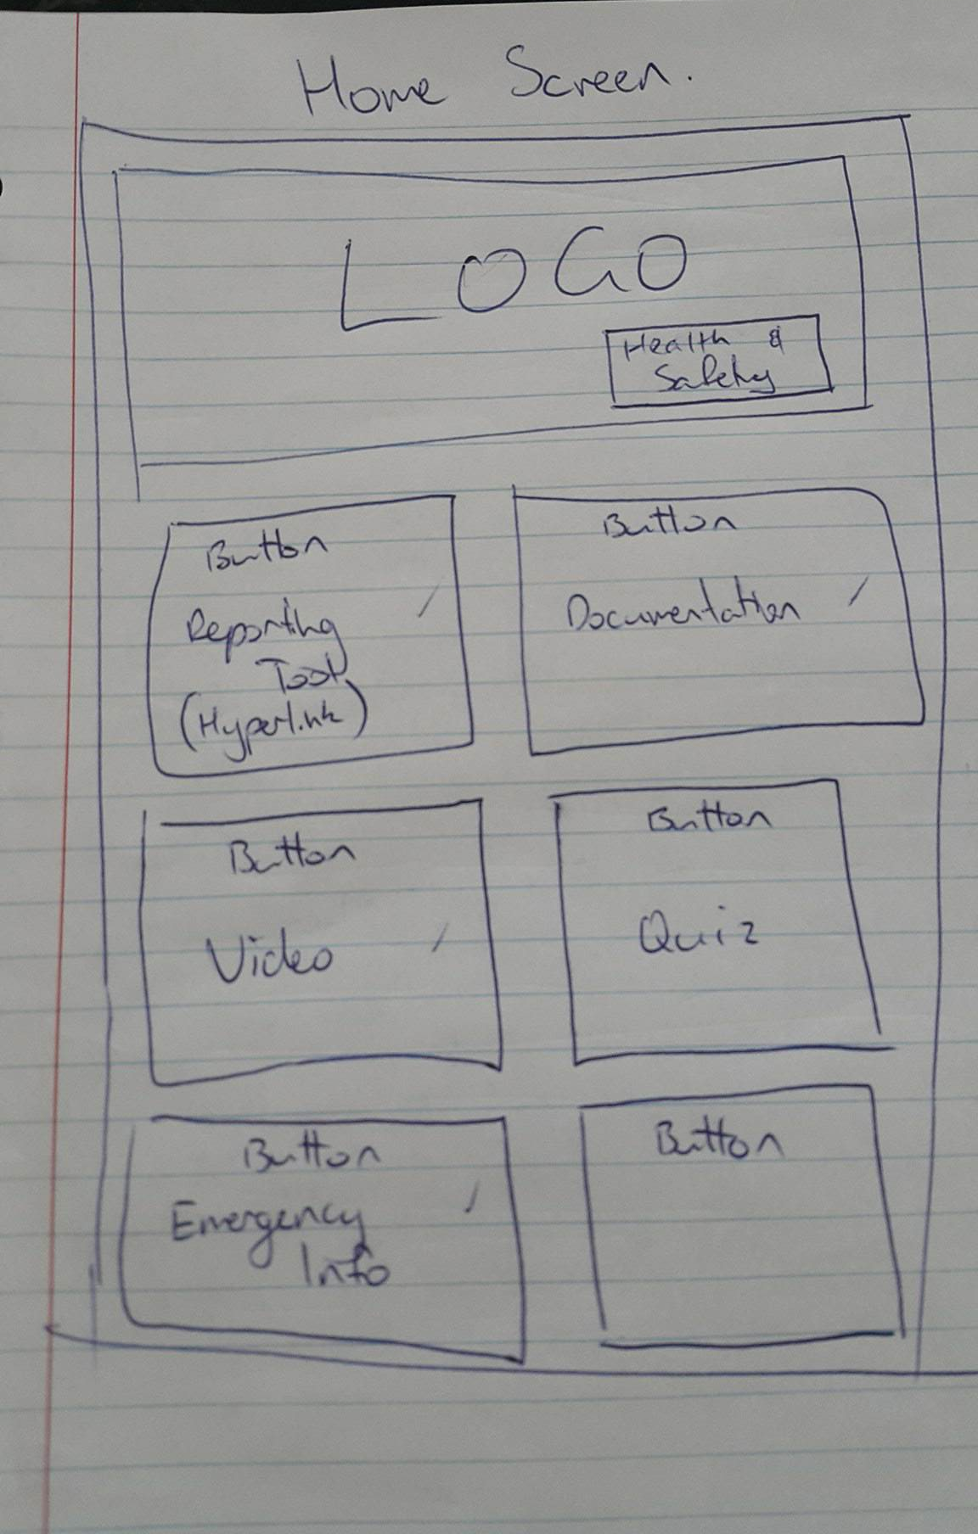
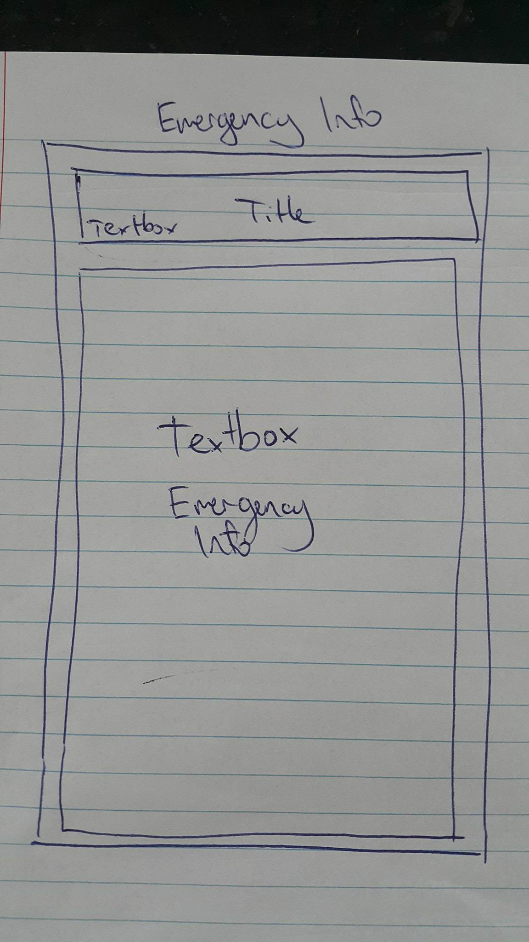
Design Sketches

Slide 6
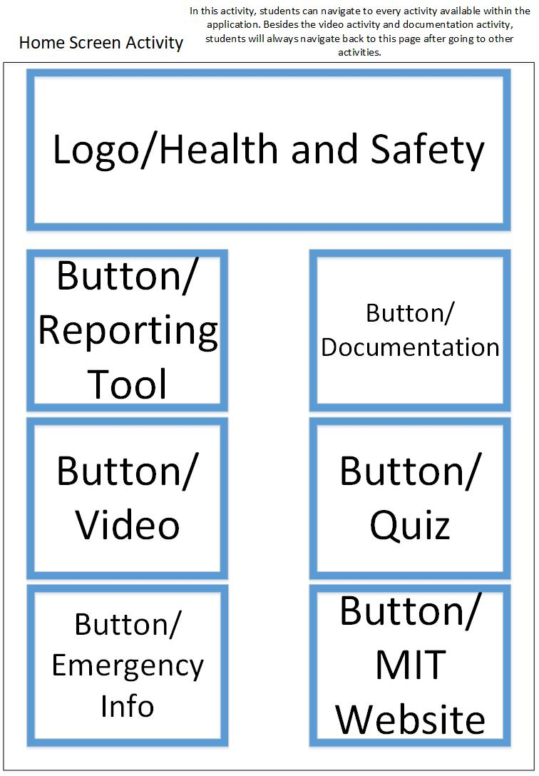
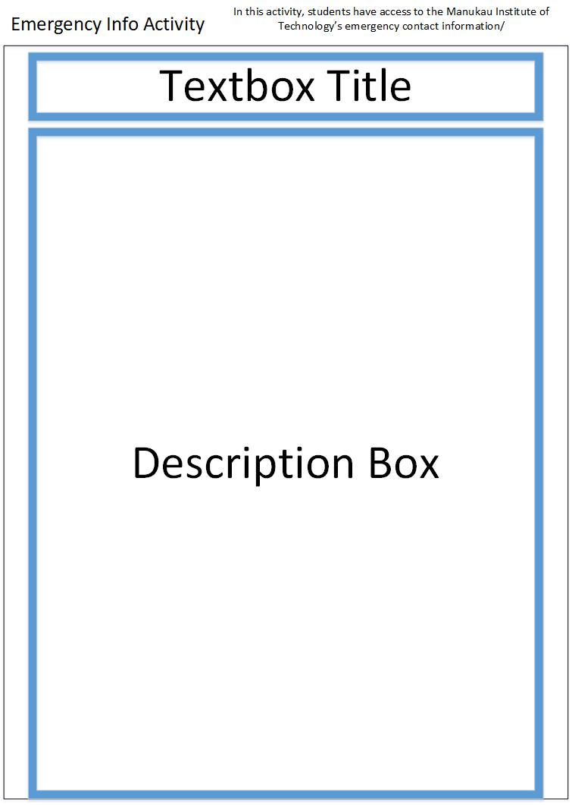
Design Wireframes

Slide 7
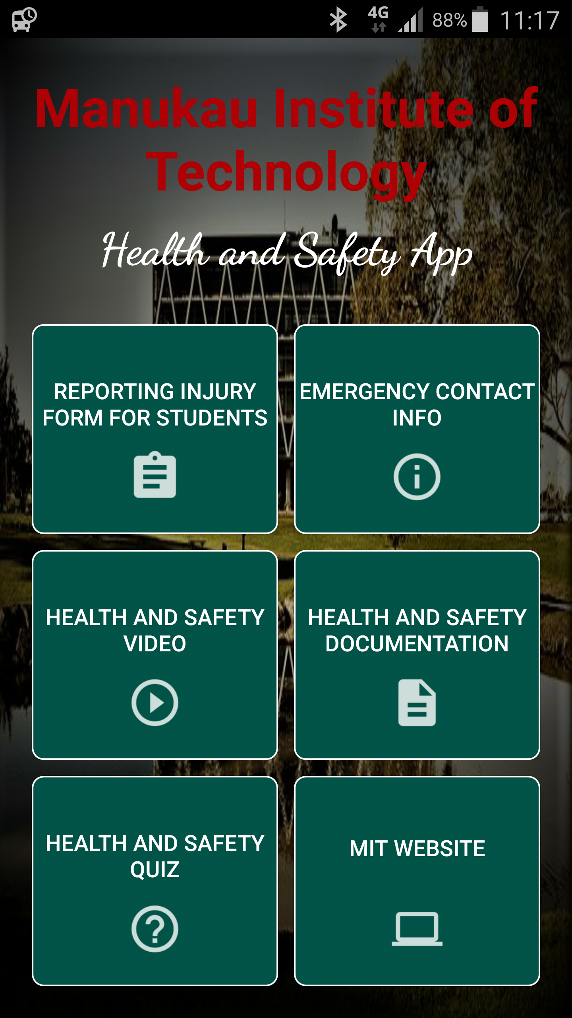
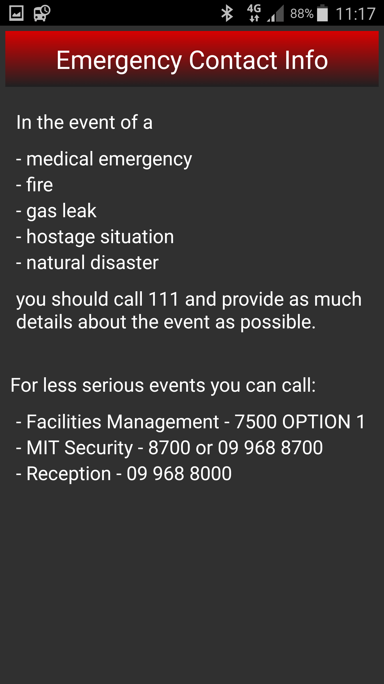
Design Final GUI

Slide 8
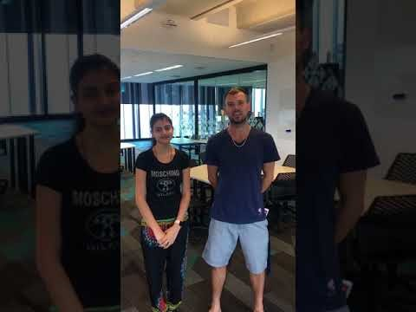
Health and Safety Video

Slide 9
Functionality of Application
Simple and easy to navigate Graphical User Interface (GUI)
Provisions for large data storage of documentation (350mb)
Produce and feature a health and safety video
A quiz feature that students can fill out once the video has been watched

Slide 10
Limitations
Design – Functionality over aesthetics.
Relevant documentation.
Databases – Student results and range of questions.

Slide 11
Responsibilities
Chris
Project Proposal
PowerPoint Presentations
Logan
Application and Landing Page
Shared
Client Meetings
Team Meetings
Publication
Testing
Design – Wireframes, Navigation diagram, Use Case diagrams

Slide 12


